Slide 1
Exploring Predictor Inductive Biases for Object-Centric Video Prediction
Master Thesis Introductory Talk
Ismail Wahdan
10.08.2022

Slide 2
Outline
Problem Statement
Related Work
Approach
First Results
Next Steps

Slide 3
Problem Statement

Slide 4
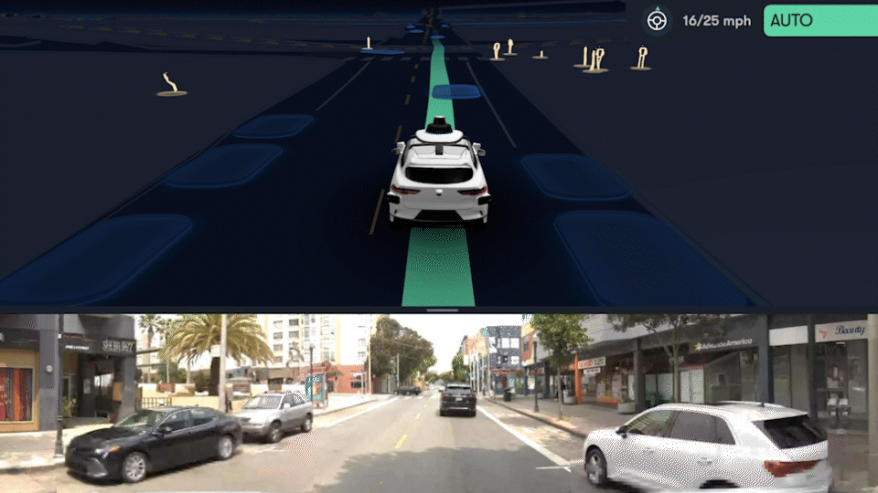
Motivation
Planning is a core ability of intelligent systems.
Requires the ability to calculate outcomes of actions.
Environment usually contains other actors and agents.
Their plans are often unknown, but their actions are observable.
An autonomous Waymo self-driving car detects the intention of someone to cross the road and stops.[4]

Slide 5
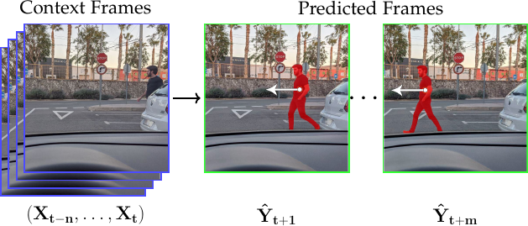
Video Prediction
Cameras are among the most utilized sensors in robotics.
Action prediction is interpreted as prediction in pixel space over frames
Given n context/seed frames, predict the following m frames
Applications: In robotics, autonomous driving, industrial health scoring
Challenges: Dynamics and rules of the real world are too complex
Source: A Review on Deep Learning Techniques for Video Prediction by Oprea et al.

Slide 6
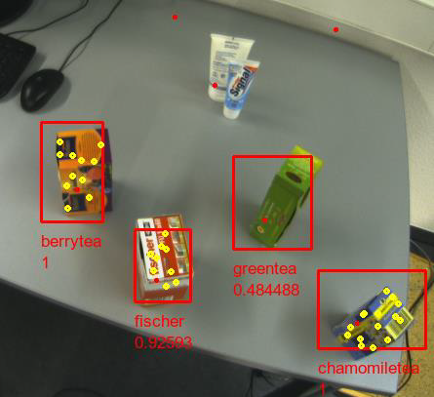
Object Centricity
Humans perceive the world in terms of objects
Objects are discrete, detectable, describable
Describable in terms of: color, location, pose, class…
Object properties facilitate modeling their interactions
Source: [Stückler, Behnke: Automatika 2011]

Slide 7
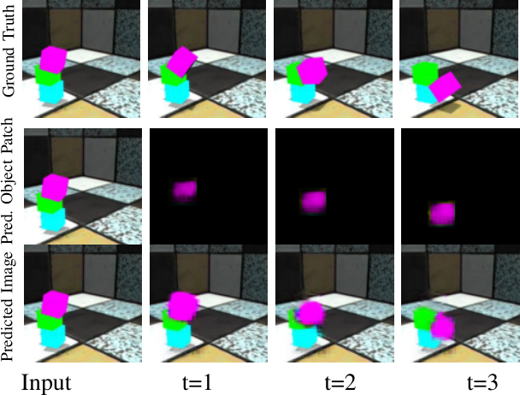
Object-Centric Video Prediction
A practical approach to video prediction
Dissect context frames into discrete objects. Predict future states of each object in an embedding space
Reconstruct the frames by decoding the predicted states back into pixel space
Source: Object-centric Video Prediction without Annotation by Schmeckpeper et al.

Slide 8
Related Work and Concepts

Slide 9
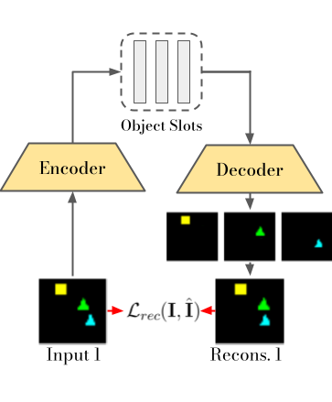
Object Slot Representation
Anticipate existence of N objects in a frame
Create variables (slots) each to be assigned an object by iteration
Learn useful object representations by using the slots to reconstruct the frame
Used for several downstream tasks: Segmentation, Object discovery and Set prediction.

Slide 10
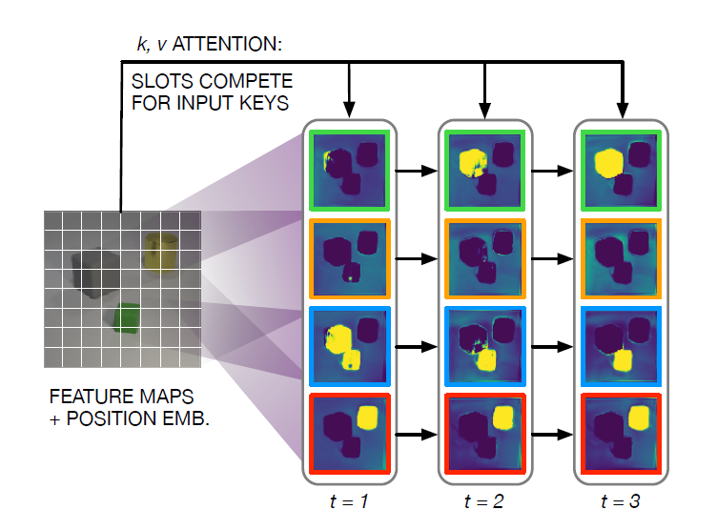
Slot Attention [1]
Mapping pixel information to slots requires attention to certain parts of the frame
Information representing objects are collected by feature maps and positional embedding
RNN iteration to enforce information collection into one slot per object (one background slot)
Attention model is used with inputs calculated from image, queries from slots
Iteration to populate slots with object information [1].

Slide 11
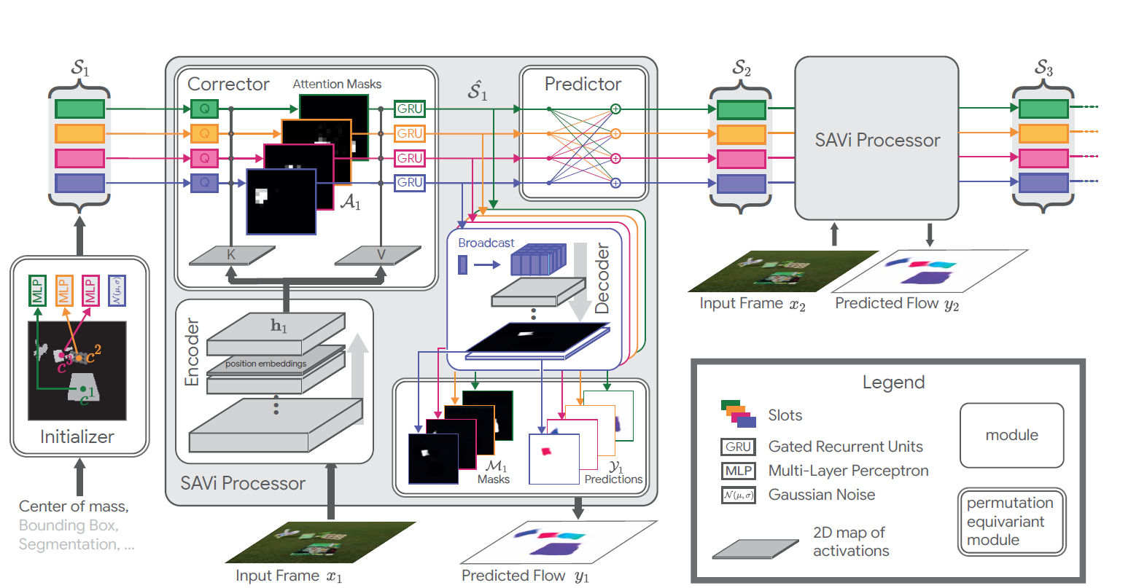
Slot Attention for Video (SAVI) [2]
Extends slot attention to videos.
Instead of random initialization, slots are predicted for next steps and then corrected.
Instead of RGB reconstruction, compares with predicted optical flow.

Slide 13
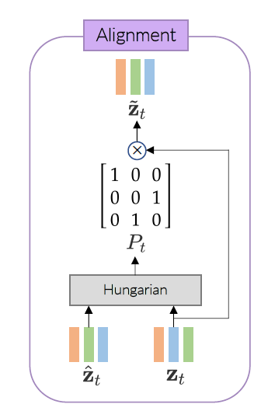
Object Centric Video Transformer (OCVT) [3]
Does not use slots and slot attention, however, uses similarly objects as token for transformer architectures.
Discusses the need for correct alignment of objects in adjacent frames so that the object-wise loss can be applied.
Applies the Hungarian algorithm for object alignment.

Slide 14
Approach

Slide 15
Proposed Approach
Using learned slot object representations, learn dynamics and apply predictions directly in slot space
Capture object properties and interactions where possible
Less dimensionality leads to more efficient prediction and focus on the more relevant details
Slot embeddings can be used to reconstruct frames, or can be used directly to capture object information and be used by other systems in an efficient manner

Slide 16
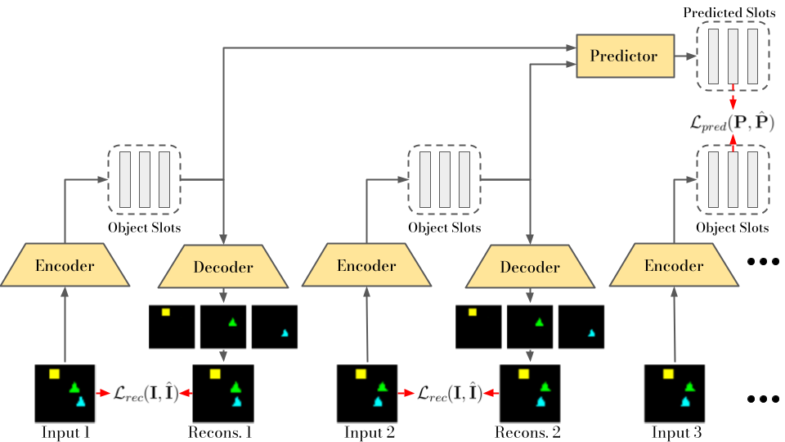

Slide 17
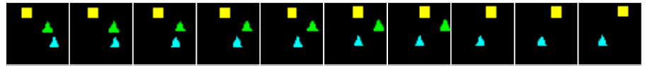
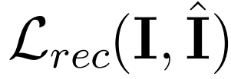
Slot Attention
Decomposes image into its object components
Working with individual images
No sequential processing
Object Slots
Encoder
Decoder
Same
Slot Attention
Input
Recons.
Input
Recons.

Slide 18
Slot Alignment
Slot Attention factorizes image into unordered Slots
Slots from consecutive images must be aligned temporally:
Computite affinity between scores (e.g. norm.cosine similarity)
Find bipartite match with Hungarian algorithm
Recovering slots for temporal alignment
1. Encoding
2. Scoring Slots
3. Hungarian & Alignment
Slots 1
Slots 2
Alignment Matrix
0.1
0.9
0.2
1.0
0
1
0
0.2
0.2
0.8
Encoder
Encoder
0
0
1
0.9
0.2
0.2
0.0
1
0
0

Slide 19
Predictor Modules

Slide 20
RNN Predictor
Slots
Predicted Slots
Works for aligned single slots at the time
For N slots, we need N RNN predictor modules
Carries the motion information in its hidden states
Cannot model interaction between objects
RNN
RNN
RNN
Seed Stage: Initializing RNN states
Predict Stage: Using state to predict future slots
RNN
RNN
RNN
RNN
Seed Slots
Predicted Slots

Slide 21
MLP Predictor
Works for aligned single slots at the time
For N slots, we need N MLP predictor modules
Explicitly models the motion between two previous slots
Cannot model interaction between objects
Slots
Predicted Slots
MLP
MLP
MLP
Step 1
Slot 1 from Image 1
Slot 1 from Image 2
MLP
+
Predicted Slot 1 from Image 3
Step 2
Slot 1 from Image 2
MLP
+
Predicted Slot 1 from Image 4
Slot 1 from Image 3

Slide 22
Vanilla Transformer
Slots simultaneously attend to all previous slots in all previous time steps
Complexity is O(N * T)
N: number of slots
T: number of time steps
MLP
Layer Norm
Masked Multi Head Attention
Layer Norm

Slide 23
Object-Centric Video Transformer v1
Attention is split into two operations
Object attention: slots attend to all other slots in the same time step
Time attention: slots attend to same slot for all previous time steps (requires alignment)
Complexity is O(N + T)
N: number of slots
T: number of time steps
MLP
Layer Norm
Time Attention
Slot Alignment
Layer Norm
MLP
Layer Norm
Object Attention
Layer Norm

Slide 24
Object-Centric Video Transformer v2
Applying both object-attention and time-attention in parallel. Attention modules are same as in v1.
This module has fewer learnable parameters and less computations than v1 version.
Complexity is still O(N + T)
N: number of slots
T: number of time steps
MLP
Layer Norm
+
Time Attention
Object Attention
Slot Alignment
Layer Norm

Slide 25
Object-Centric Transformer Predictor
Works for all slots at the time
Explicitly models the motion between time steps
Can model interaction between objects
Redundant Preds
Actual Preds
Redundant Preds
Actual Preds
Redundant Preds
Actual Preds
Transformer
Transformer
Transformer
Input Slots (context)
Input (shifted context & last preds)
Input (shifted context & prev. preds)

Slide 26
Current Results

Slide 27
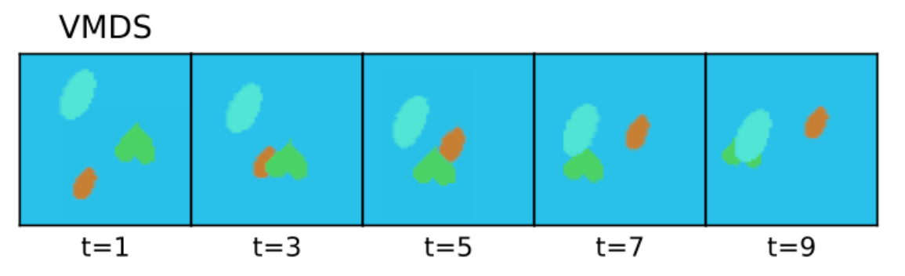
Dataset
We are currently training on the Video Multi-dSprites (VMDS) dataset, a video extension of the Multi-dSprites dataset.
10 frame videos with a maximum of 5 free moving objects.
The Slot attention model is trained with 6 slots.

Slide 28
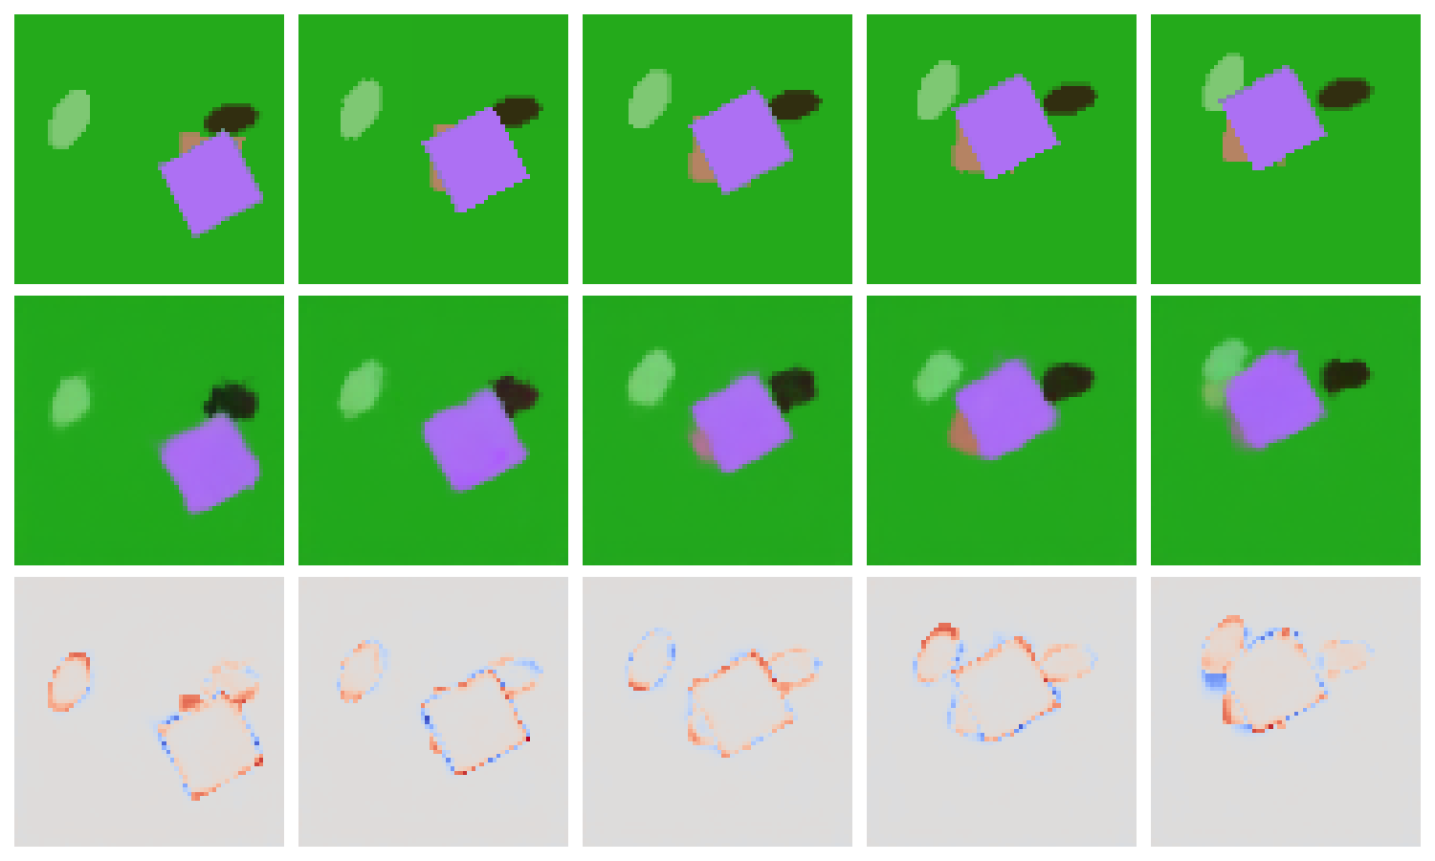
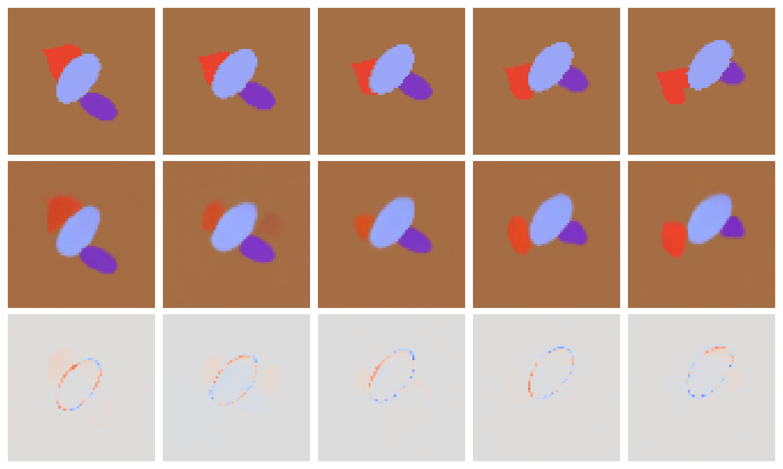
Slot Attention Training Result
Our current best result training our version of slot attention has an Adjusted Rand Index (ARI) score of 0.85, compared to 0.91 reported on the Multi-D-Sprites dataset[1].

Slide 29
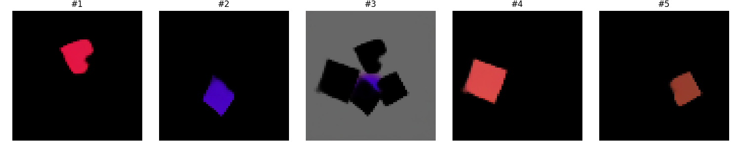
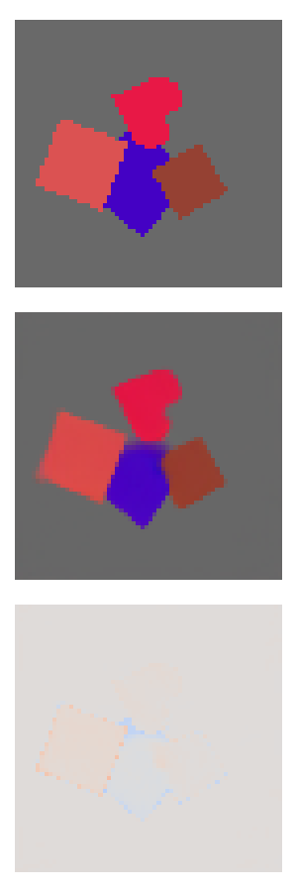
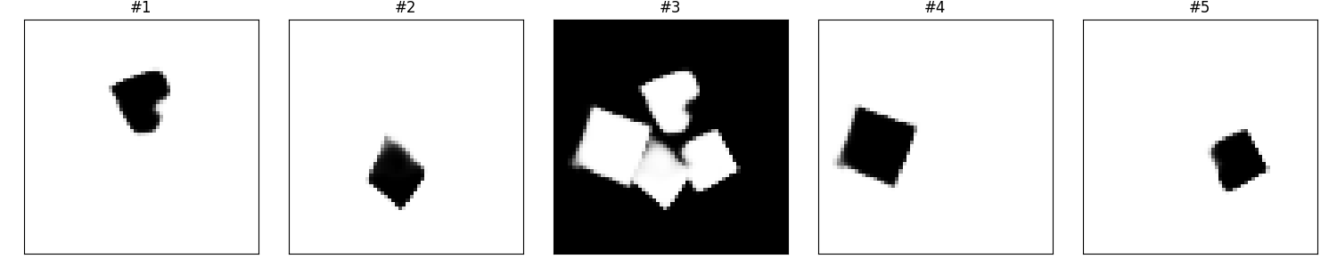
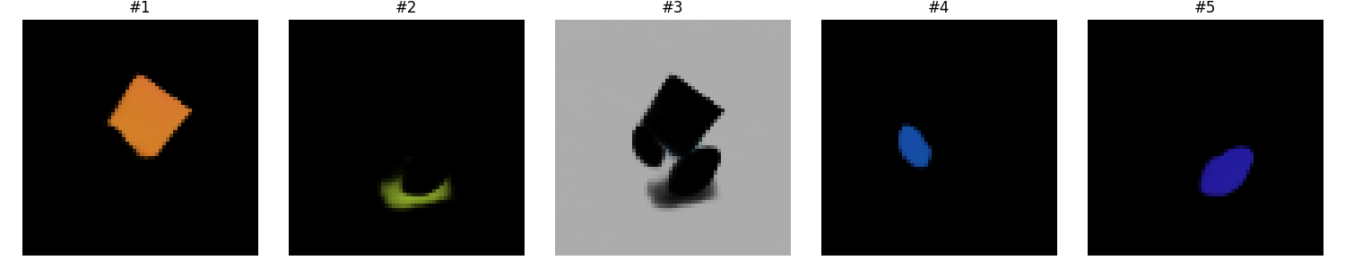

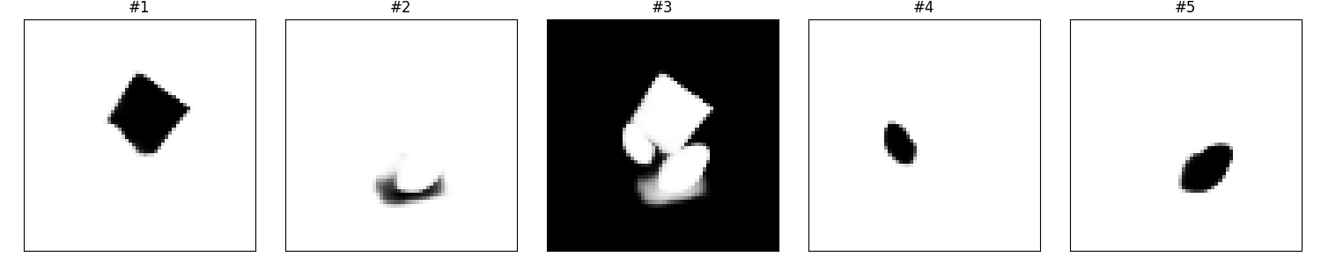
Target
Recons.
Decomposed Objects and Masks

Slide 30
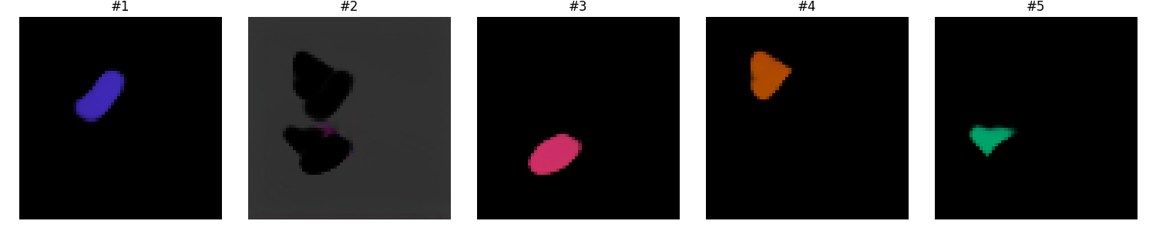
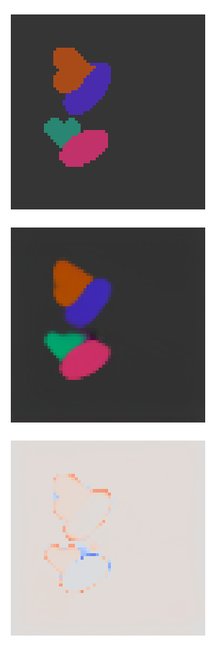
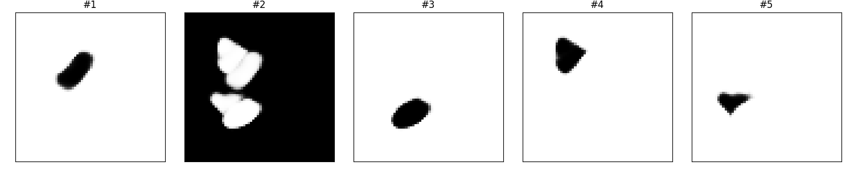
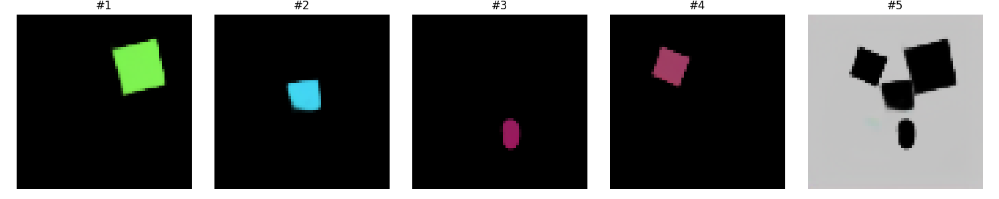
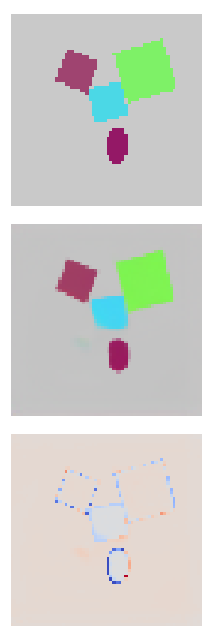
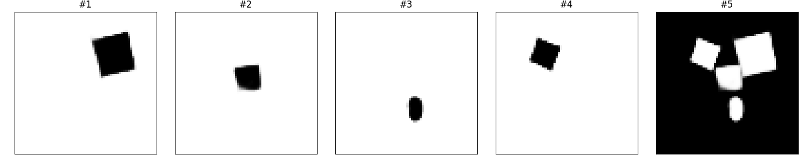
Target
Recons.
Decomposed Objects and Masks

Slide 31
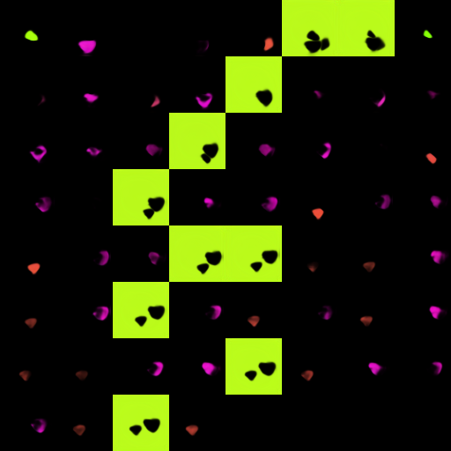

Object Decomposition

Slide 32
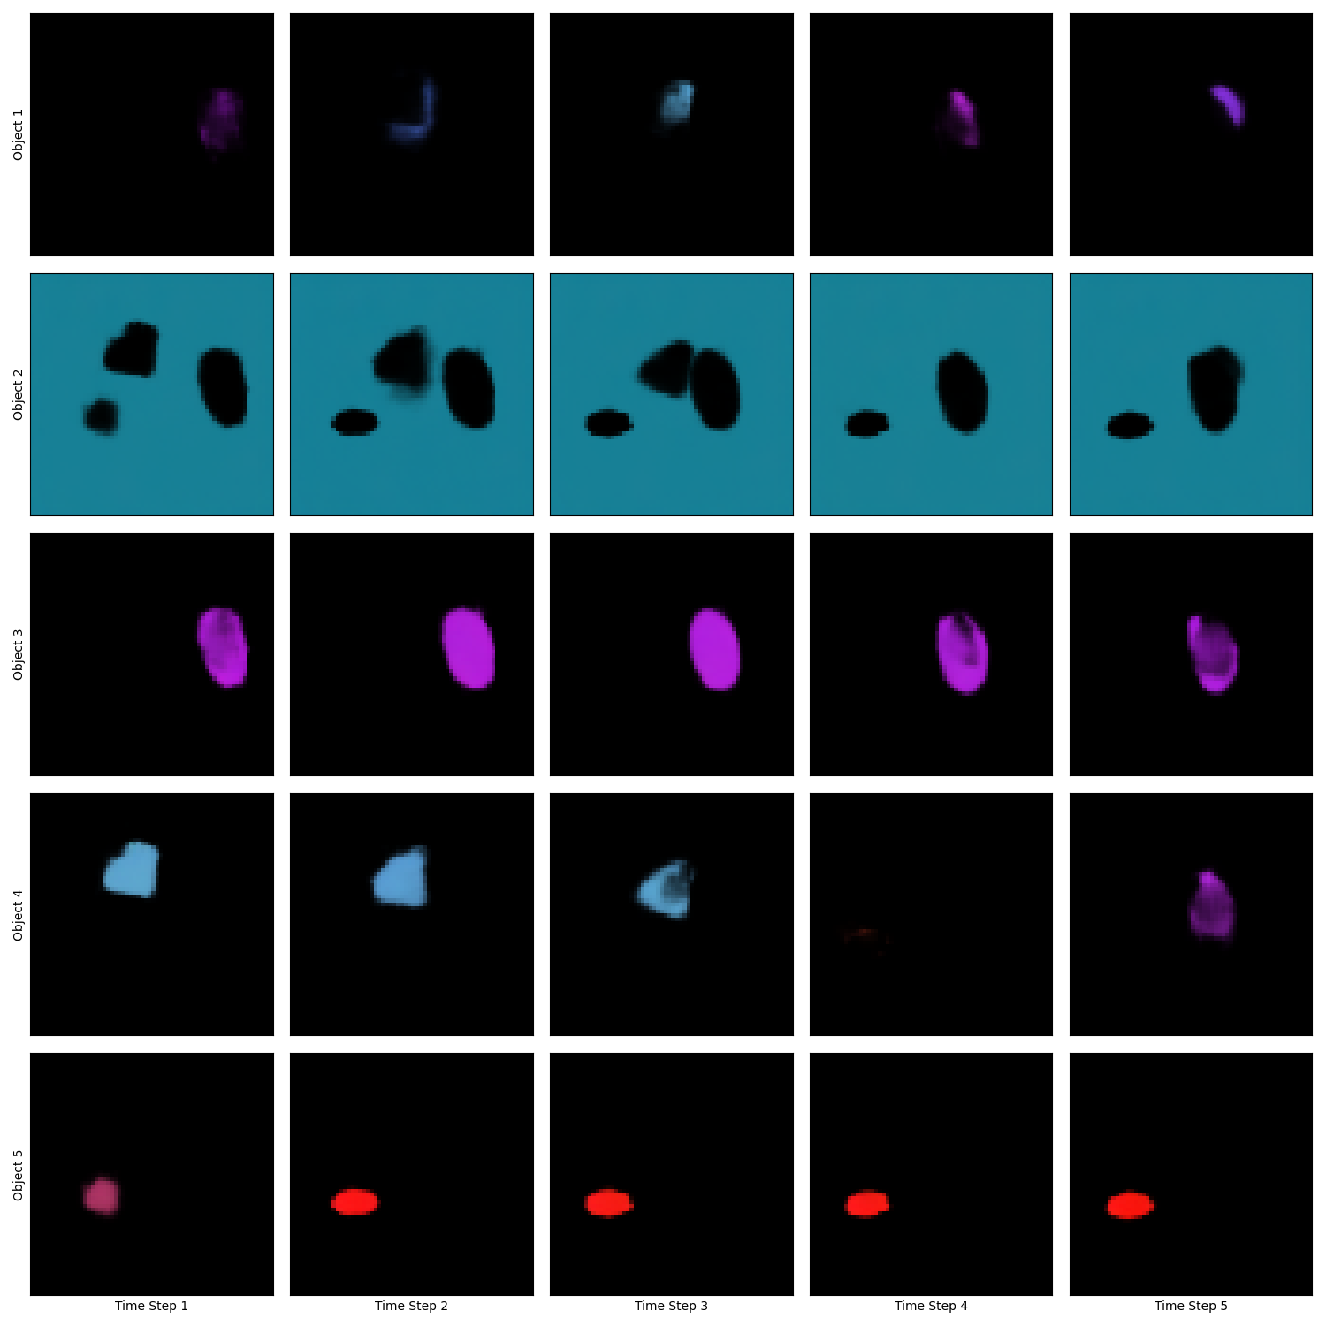
Slot Alignment
Visual evaluation of slot alignment using the Hungarian method shows satisfactory results.
Problems arise when number of slots does not match number of actual objects.
Suggestion: modified SAVI (T.B.D)

Slide 33
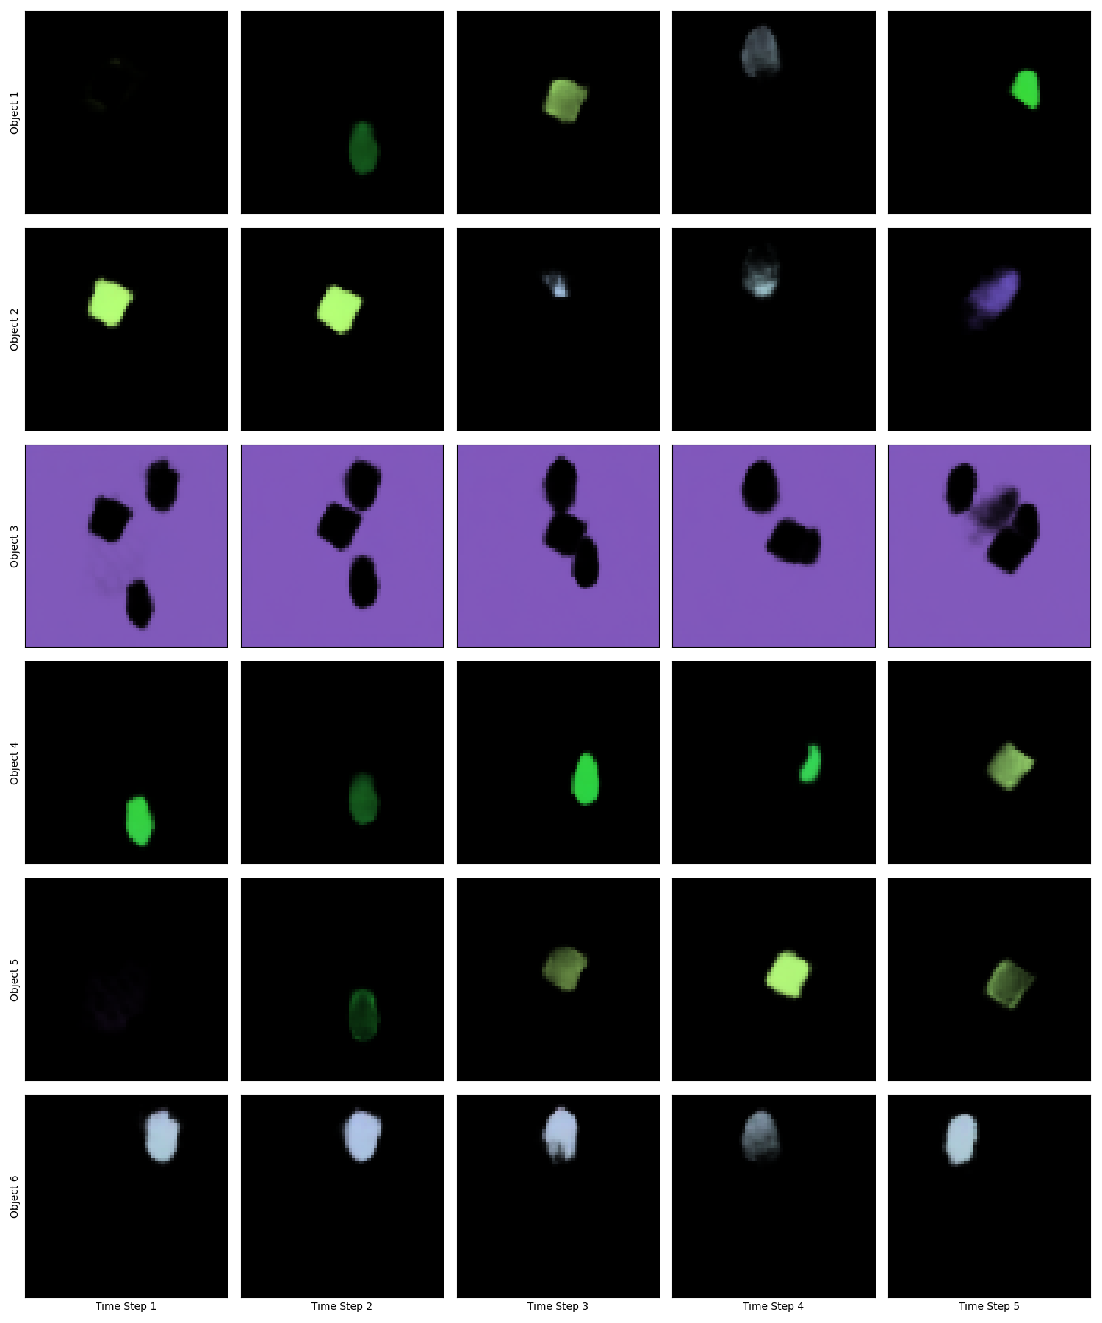
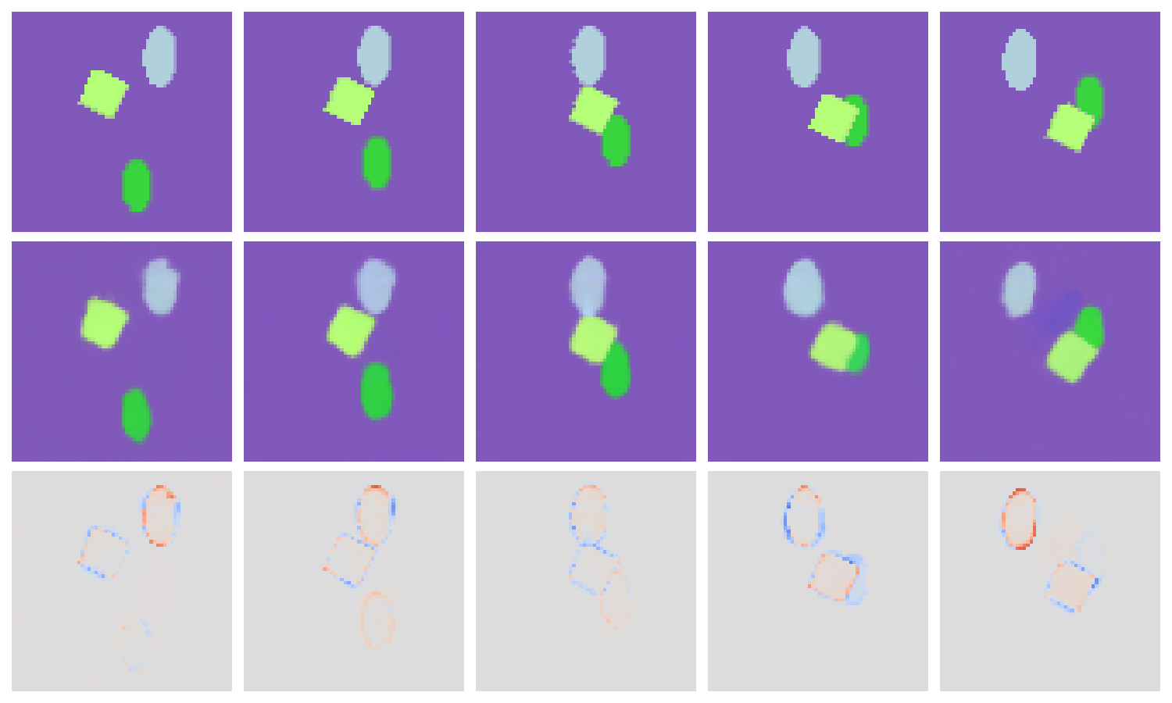
Aligned Slots
Target Sequence
Recons. Sequence
Time

Slide 34
Next Steps

Slide 35
Implement and Debug Predictors
Extract slots using pretrained SlotAttention/SAVI model
Implement and debug predictors and Hungarian using encoded slots:
Make sure Hungarian matching is reliable
Check predictor modules are able to perform the prediction task
a)
Is this true?
b)
Can predictors do this? How well can they?
0.1
0.9
0.2
1.0
0.2
0.2
0.8
Predictor Module
0.9
0.2
0.2
0.0

Slide 36
Evaluating Predictor Module
Multi-Object Segmentation and Tracking:
We will evaluate slot alignment with the Hungarian method by Multi-Object tracking metrics
If needed, we can add extra loss functions to learn representations that are easier to align (e.g. Contrastive Loss)
Video Prediction:
We will evaluate video prediction using regular metrics of image reconstruction, eg PSNR, SSIM, LPIPS
We will compare results with non-object-centric baselines such as ConvLSTM or SVG

Slide 37
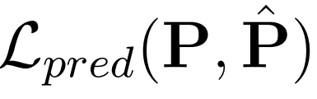
End-to-End Training
Simultaneous training of slot-decomposition and predictor modules
End-to-end approach
Convergence might be complicated
Train slot-model + joined fine tuning
Predicted Slots
Predictor
Object Slots
Object Slots
Object Slots
Encoder
Encoder
Decoder
Encoder
Encoder
Decoder
Decoder
Input 1
Recons. 1
Input 2
Recons. 2
Input 3

Slide 38
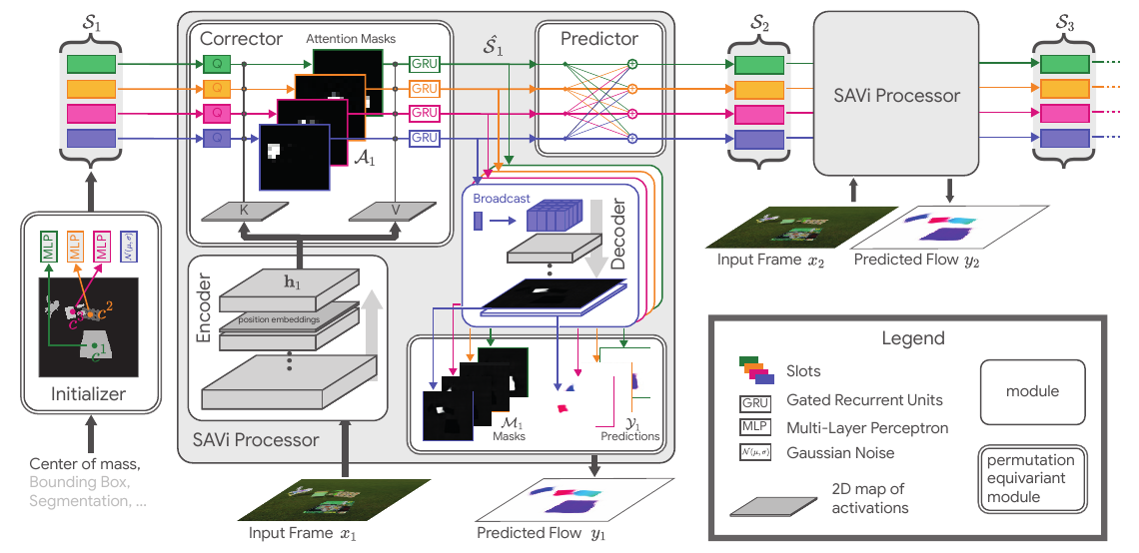
SAVI
Using SAVI instead of Slot Attention
Sequential processing for better slot modelling
Frame t+1 refines the slot representations of frame t

Slide 39
Literature
[1] Locatello, Francesco, et al. "Object-centric learning with slot attention." Advances in Neural Information Processing Systems 33 (2020): 11525-11538.
[2] Kipf, Thomas, et al. "Conditional object-centric learning from video." arXiv preprint arXiv:2111.12594 (2021).
[3] Wu, Yi-Fu, Jaesik Yoon, and Sungjin Ahn. "Generative Video Transformer: Can Objects be the Words?." International Conference on Machine Learning. PMLR, 2021.
[4] Utilizing key point and pose estimation for the task of autonomous driving, Waymo blog. Link: https://blog.waymo.com/2022/02/utilizing-key-point-and-pose-estimation.html

Slide 40
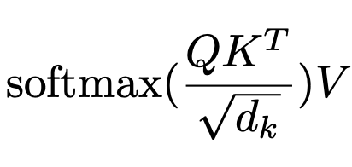
Thanks for your
Questions?

Slide 41
Appendix

Slide 42
Datasets

Slide 43
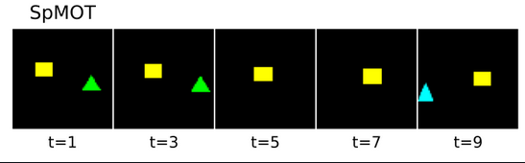
Sprites-MOT
Video dataset
Maximum of 3 objects per frame
Black background with sometimes totally empty frames

Slide 44
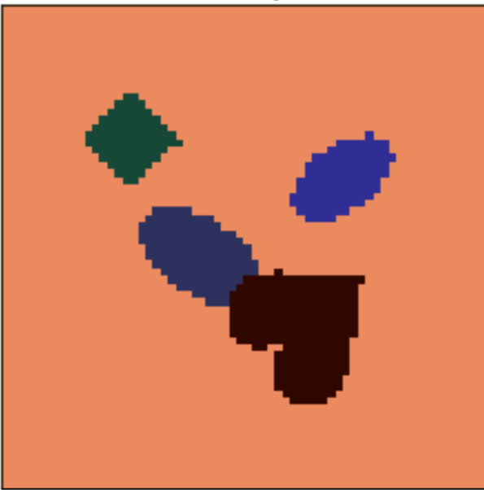
Multi-dSprites
Images dataset
Maximum of 5 objects per frame
Extended to VMDS

Slide 45
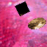
Textured Video Multi-dSprites (texVMDS)
More advanced video dataset
Obscurities in scenes, complex backgrounds
Harder test for the model’s capabilities when needed

Slide 46
More Results

Slide 47
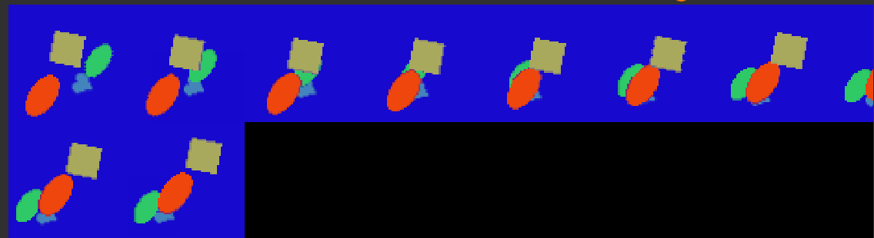
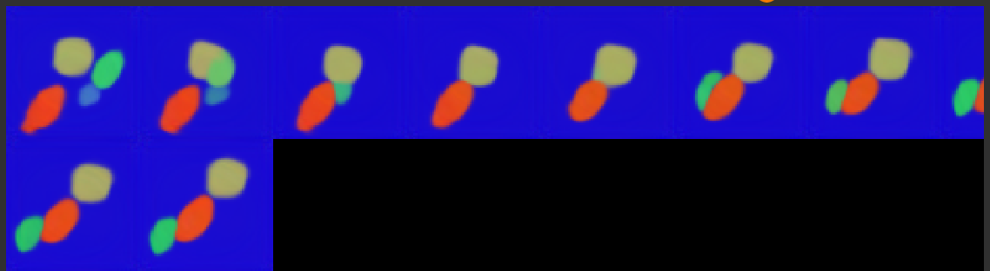
Slot Attention Reconstruction

Slide 48
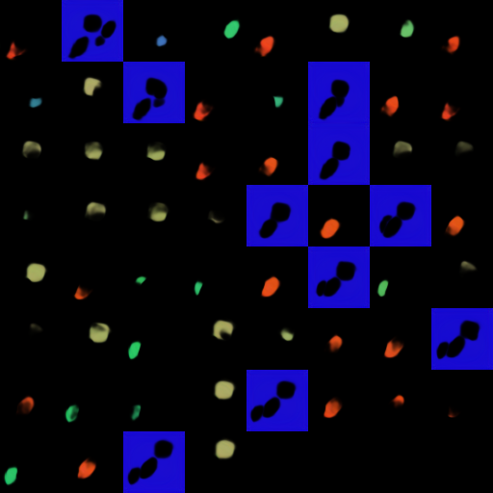
Slot Attention Decomposition

Slide 49
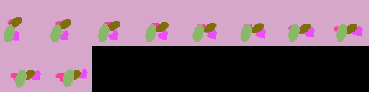
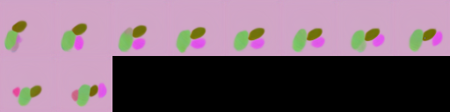
Slot Attention Reconstruction

Slide 50
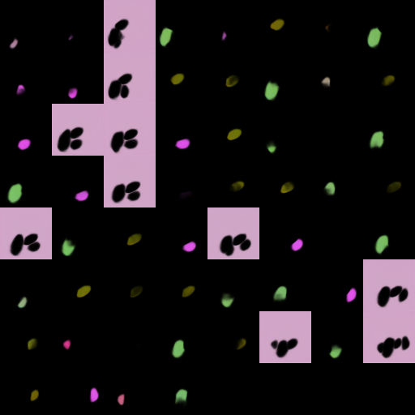
Slot Attention Decomposition

Slide 51
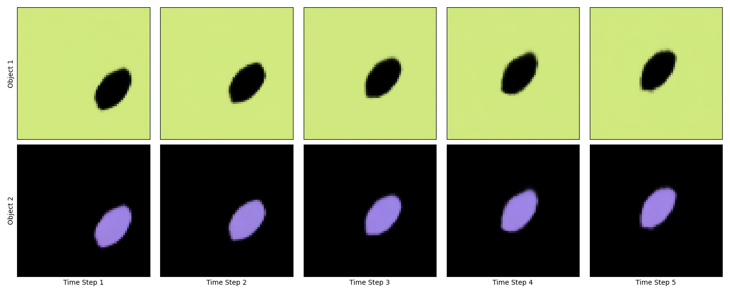
Slot Alignment

Slide 52
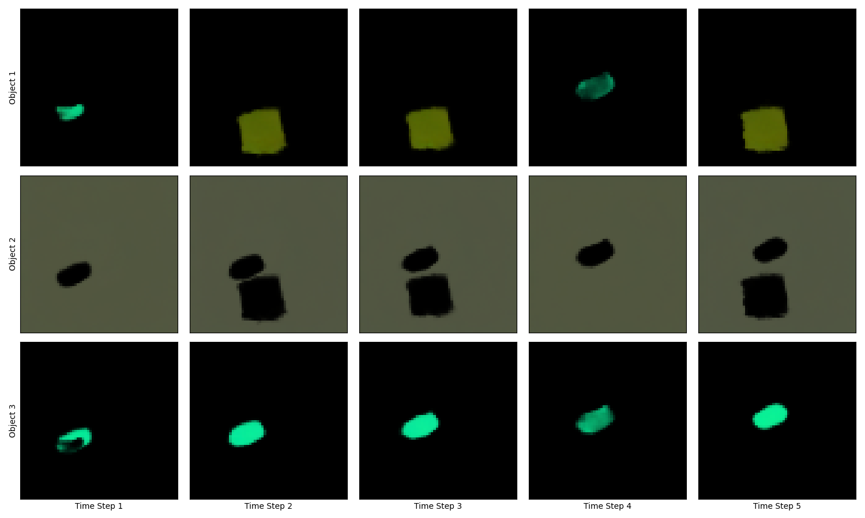
Slot Alignment

Slide 53
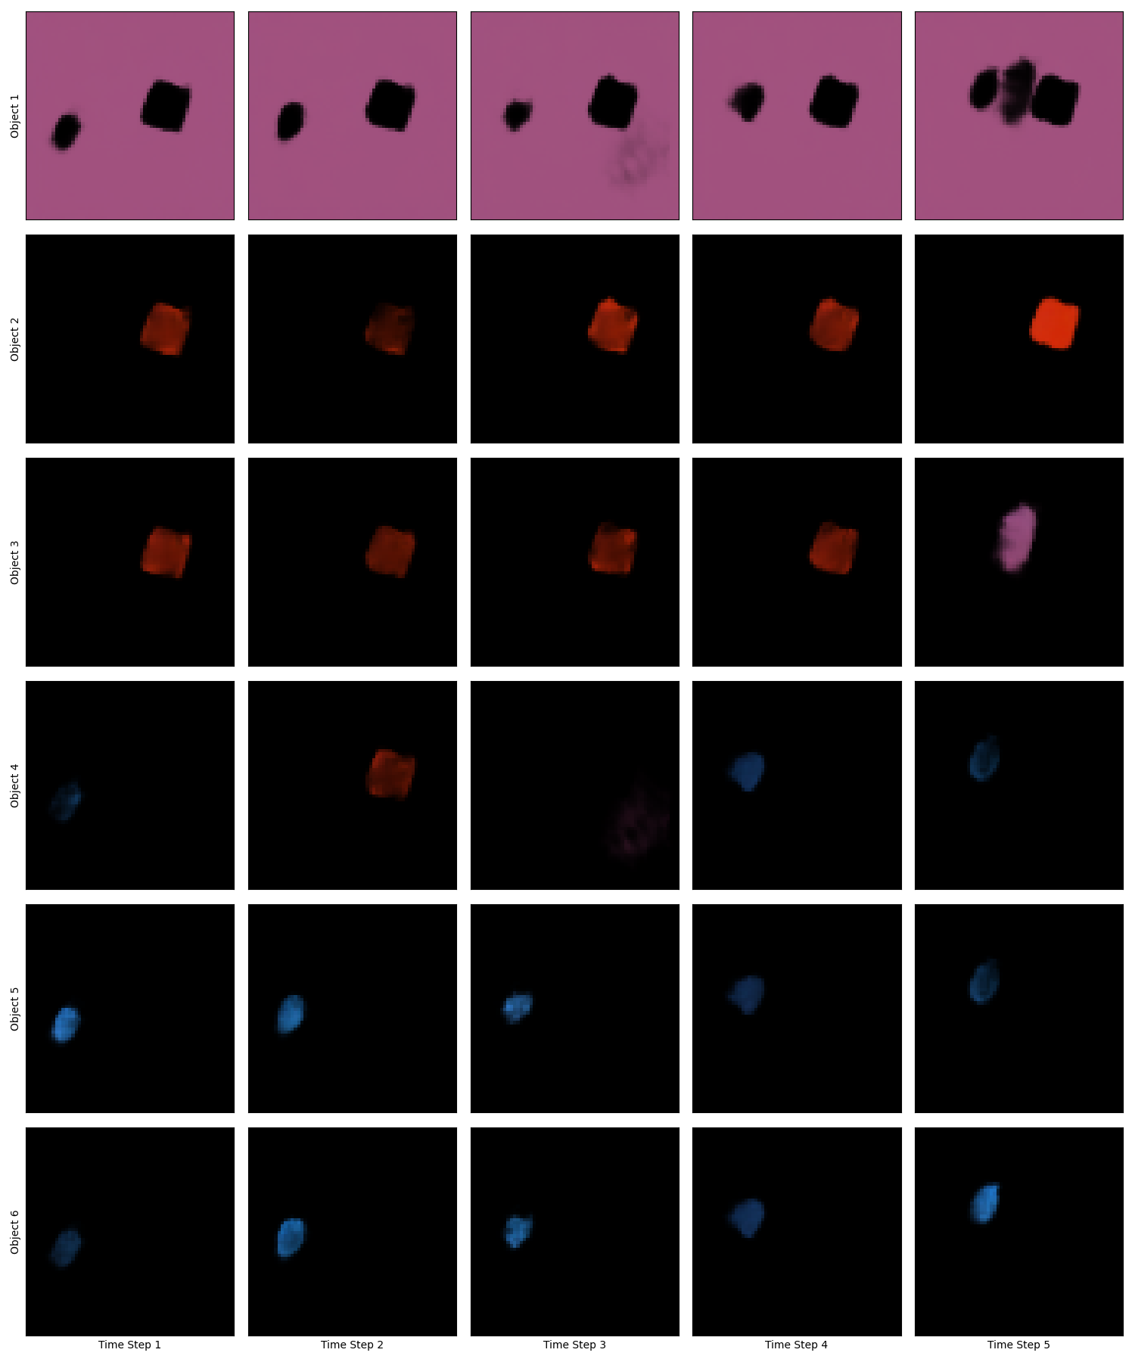
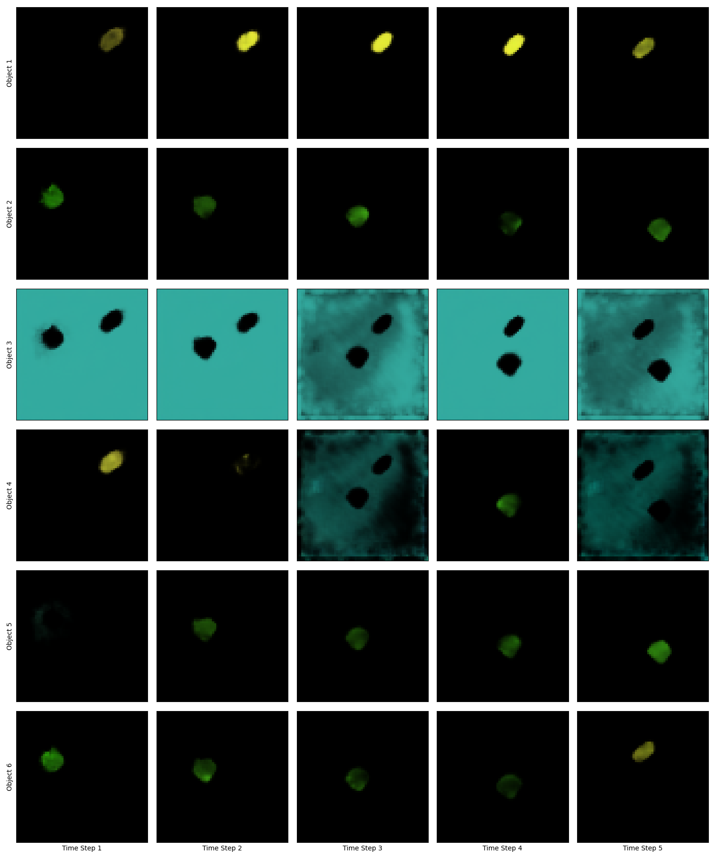
Slot Alignment (Fixed Slot Number)

Slide 54
Current Difficulties and Suggested Ideas
Blurry edges of objects:Try increasing capacity of model, e.g., by increasing slot dimension
Slot Sensitivity to initialization: SAVI style initialization
When frame has less number of objects than slots objects are split among the slots
Slot Alignment works better when there is a 1-1 relation between slots and objects

Slide 55
Prediction Flow for RNN and MLP
Aligning slots of seed frames
Autoregressive prediction of future slots
Alignment during seed stage
Predicted slots are already ‘aligned’
1)
1.0
2)
0.1
0.9
0.2
RNN
RNN
RNN
RNN
0.2
0.2
0.8
0.9
0.2
0.2
Seed Stage
Prediction Stage
0.0

